Slide 1
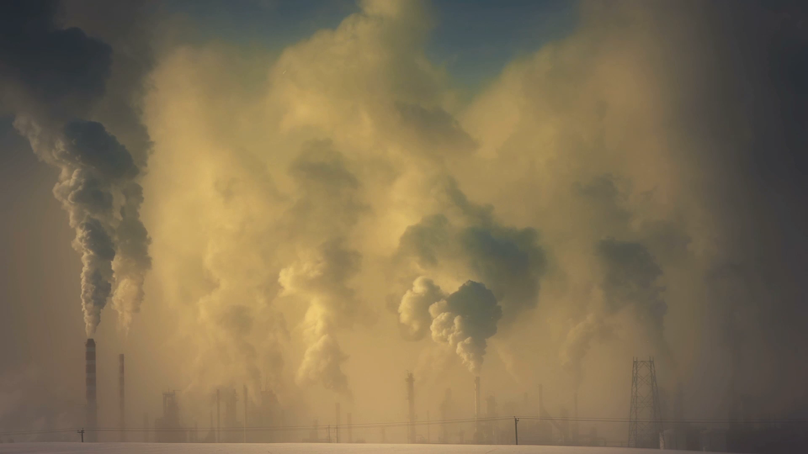
CO2 Emissions and Sources: A Comparative Study in Bangladesh
Course Title: Seminar VIII
Course Code: ECO 498

Slide 2
Supervised by: Md. Akther Husain Assistant Professor Department of Economics
Submitted by: Muammer Galib Mahdi 2017231019

Slide 3
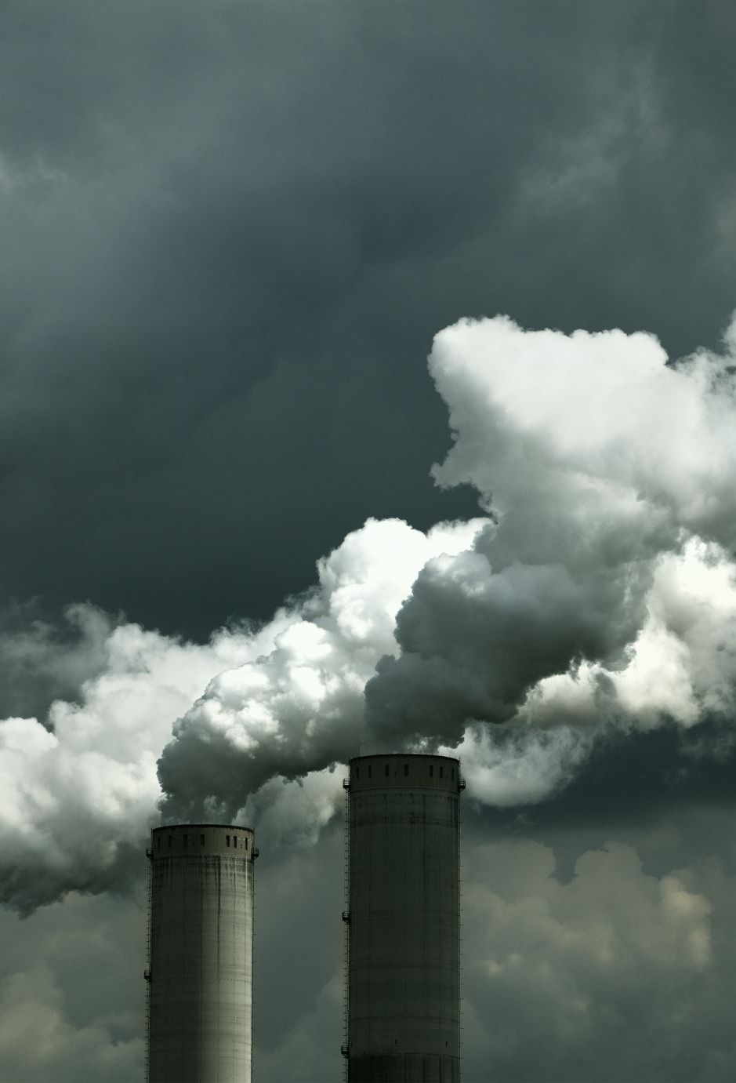
Introduction
C02 emission tripled: globally within 54 years(1960-2014) and in Bangladesh within 23 years(1991-2013)
Industrialization being the main cause, leading to global warming and major changes in climate.
Economic growth and environmental sustainability are in a delicate balance.

Slide 4
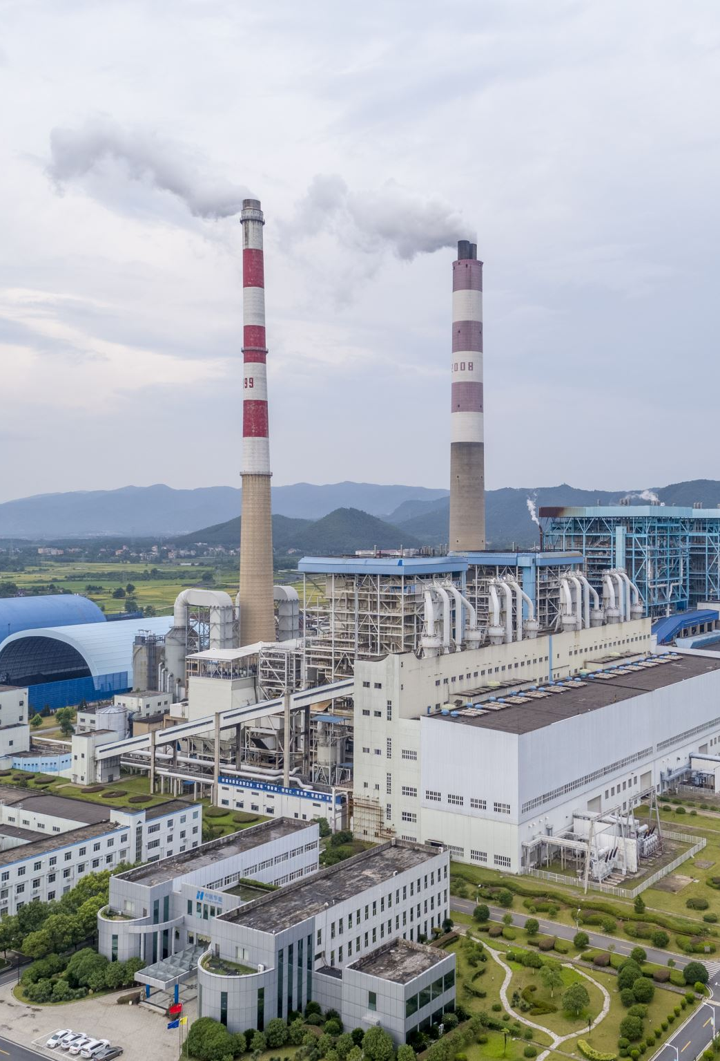
IPCC and CO2 Emissions:
The 5th IPCC Review Article recommends global temperatures shouldn’t rise beyond 2°C by the 21st century's end.
The world has seen an increase in CO2 emissions from 9385.8 million tons to 36,138.3 million tons from 1960 to 2014.
The manufacturing and construction industries were responsible for nearly 19.96% of CO2 emissions in 2014.

Slide 5

Effects of Climate Change:
Low summer river flows, higher seasonal temperatures, glacial retreats, floods, and sea-level rise.
CO2 emissions pose a threat to health and well-being of the population.
lower household incomes and increased poverty indirectly.

Slide 6
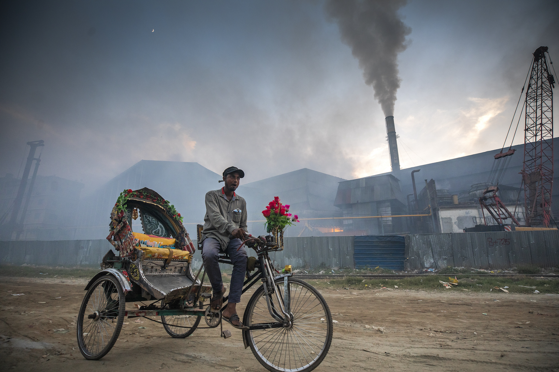
CO2 Emissions in Bangladesh:
The manufacturing and service sectors run on fossil fuels such as coal, crude oil, and natural gas.
The power sector is a major contributor to CO2 emissions in Bangladesh.
Natural gas accounts for around 62.90% of electricity generation in Bangladesh.
These are directly related to CO2 emissions.

Slide 7

Objective:
The objective of this study is to analyze the level of CO2 emissions in Bangladesh resulting from different sources.
The study will focus on urbanization, industrialization, manufacturing industries and construction, commercial and public services, and consumption of various non-renewable fuels.
The level of CO2 emissions nearly tripled from 3.22 million tons to 10.65 million tons from 1991 to 2013 in Bangladesh.
The study aims to identify the major contributors to CO2 emissions in Bangladesh and gain a better understanding of which sectors to tackle first to regulate the current status quo.

Slide 8

Literature Review
Unidirectional causality from industrial development to CO2 emissions and energy consumption. (Rahman & Kashem, 2017)
Electricity consumption and financial development adds to CO2 emissions. (Shahbaz et.al., 2014)
The Environmental Kuznets Curve (EKC) model reveals that the turning point for the manufacturing industry occurs at a lower level of per capita GDP compared to the construction industry. (Yu Zhang et al., 2019)

Slide 9

Literature Review (Cont.)
Technical progress reduces CO2 emissions at all quantiles. Impact of technical progress is more significant in the manufacturing sector compared to the industrial sector. (Raza & Hasan, 2022)
Increase in carbon emissions results from Bangladesh’s reliance on fossil fuels. Renewable energy-based technologies have reduced CO2 emissions in Bangladesh by 10–30%. (Karmaker et al., 2020)
Found indication of efforts toward energy efficiency and clean energy and highlighted the importance policies and strategies that prioritize the development of renewable energy sources. (Hasan & Chongbo, 2020)

Slide 10
Data and Methodology:
World Development Indicators (WDI) database
For the period of 2007-2019
Analysis using statistical software such as Excel and R
Analysis involves descriptive and summary statistics as well as graphs and tables to provide a visual representation

Slide 11
Data and Methodology (Cont.)
CO2 emissions, CO2 emissions per capita and CO2 emissions from different sources due to various production or economic activity.
electricity and heat production
manufacturing industries and construction
other sectors, excluding residential buildings and commercial and public services
residential buildings and commercial and public services
transport
gaseous, liquid and solid fuel consumption

Slide 12

Findings:
CO2 emissions from electricity and heat production is the highest at 49.47%, followed by CO2 emissions from manufacturing industries and construction at 17.45%.
CO2 emissions from transport have a relatively low mean contribution to total emissions at 14.68%, but it has a narrow range of variation compared to other sectors.
CO2 emissions from gaseous fuel consumption contribute the most to the total emissions, with a mean of 75.15%.

Slide 13

Findings:
The mean contribution of CO2 emissions from solid fuel consumption is the lowest among all sectors at 5.93% whereas liquid fuel consumption has the second-highest mean contribution at 24.07%.
CO2 emissions from the sources are relatively high for some sources, such as CO2 emissions from electricity and heat production (1.92), CO2 emissions from residential buildings and commercial and public services (1.12), and CO2 emissions from gaseous fuel consumption (3.29).
CO2 emissions from transport (0.70) and CO2 emissions from solid fuel consumption (0.46) are relatively low, indicating less variability in the levels of emissions from these sources.

Slide 20
Conclusion:
Though faster economic development is desirable for any country, development at the cost of environmental sustainability could be detrimental to the long-term progress for any nation.
In our study, we found that,
Global CO2 Emissions have almost continuously increased from 1960 to 2014. And it can be solely attributed to Industrialization and Transportation sector of the global economy.
Bangladesh’s over reliance on fossil fuel is the major problem for the development aspect of our economy. CO2 emission is the highest in Electricity and Heat production of the country which contributes to (49.47%).
This Electricity Production is mainly dependent on Gaseous Fuel (75.15%).

Slide 21
Recommendation:
In conclusion, our policy makers need to:
Diversify our fuel source and,
Invest in Technological Progress to tackle the adverse effects of climate change and ensure ‘Sustainable Economic Growth.’

Slide 22

Limitation:
There were certain limitations we faced while conducting our study:
There were some data missing for some indicator for year 2015-2019
Further study needs to be conducted with more than one source of data.
Other factors that may influence CO2 emission such as population size, government policies and Economic growth were not considered while conducting this study.

Slide 23

Any Questions?

